Slide 1

HEALTHCARE DATA ANALYSIS
Created by –
Vennela Sai

Slide 2
DATASET OVERVIEW
The data had 55,505 rows and 15 columns
The dataset was not clean (Had duplicates, NULLS, Patient names, Hospital names and billing amount columns were not formatted properly )
It had information related to patients' health details, including age, gender, blood type, medical conditions, admission dates, discharge dates, doctors in charge, hospitals of admission, insurance providers, billing amounts, room numbers, admission types, prescribed medications, and test results

Slide 3
TOOLS USED
SQL
Power BI

Slide 4
STEPS FOLLOWED
Step 1 : Imported the file into SQL.
Step 2 : Identified abnormalities in the data.
Step 3 : Performed data cleaning to ensure consistency and accuracy.
Step 4 : Applied normalization to structure the data efficiently.
Step 5 : Established one-to-many relationships between tables using a star schema design.
Step 6 : Utilized Power BI’s DAX and charts to create visualizations and derive insights

Slide 5
FINDINGS

Slide 6
A total of 54,966 patients were included in the analysis.
The average billing amount per patient was ₹25,544.
The average length of stay was 15.5 days.

Slide 7
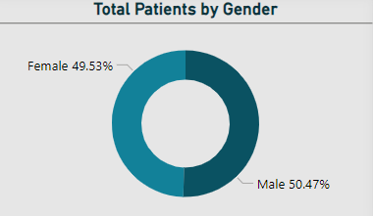
1. What is the distribution of gender across patients?
The distribution is nearly balanced, with a slight predominance of males over females

Slide 8
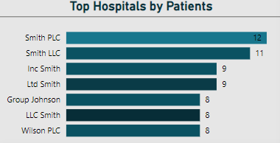
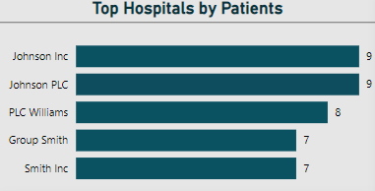
2. Which hospitals have the highest patient volumes for specific medical conditions?
Smith PLC leads in arthritis cases.
Johnson Inc. and Johnson PLC share the top spot for asthma patients.
PLC Williams and Smith Group have the highest cancer patient numbers.
LLC Smith dominates in diabetes and hypertension cases.
Ltd. Smith leads in obesity cases.
Arthritis
Asthma

Slide 9
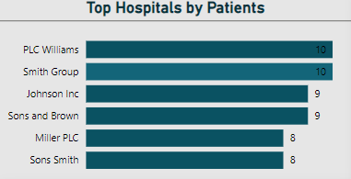
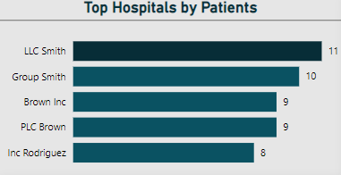
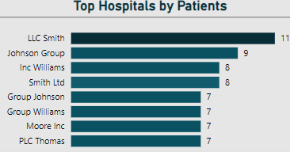
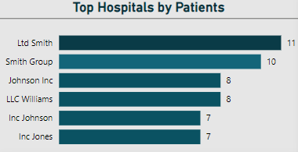
Cancer
Diabetes
Hypertension
Obesity

Slide 10
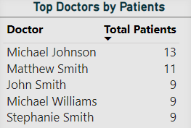
3. Which doctors have treated the highest number of patients?
Michael Johnson has attended to the largest number of patients

Slide 11
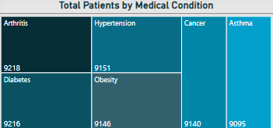
4. Which medical condition is the most prevalent and which is the least prevalent among all patients?
Arthritis is the most prevalent medical condition among patients, followed by diabetes
Whereas asthma is the least prevalent medical condition

Slide 12
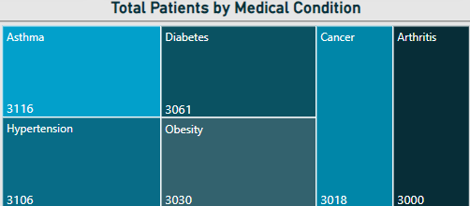
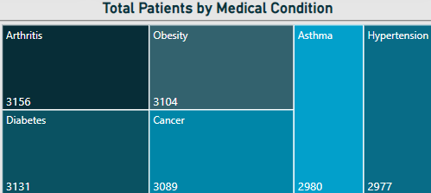
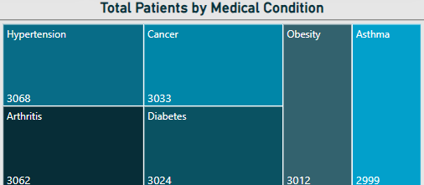
5. Which medical condition has the highest number of diagnosed patients based on test
results?
Among all patients, those suffering from asthma showed "normal" test results
Among all patients, those suffering with arthritis received "abnormal" test results.
Hypertension and arthritis have the highest number of patients with "inconclusive" test results
Normal
Abnormal
Inconclusive

Slide 13
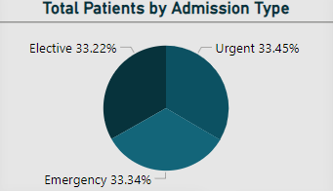
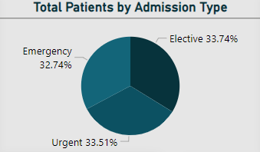
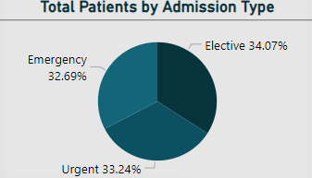
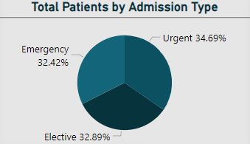
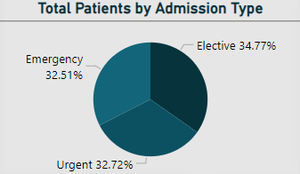
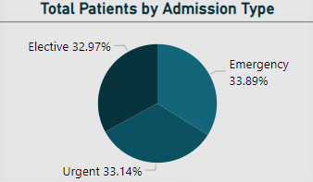
6. What is the distribution of patients by admission type for each medical condition
Nearly all medical conditions exhibit a similar distribution of admission types, with no significant variations observed across different conditions.
Arthritis
Asthma
Cancer
Diabetes
Hypertension
Obesity

Slide 14
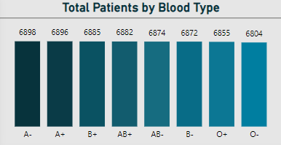
7. Which blood group has highest number of patients?
The patients are nearly equally distributed across all blood groups, with only negligible differences observed

Slide 15
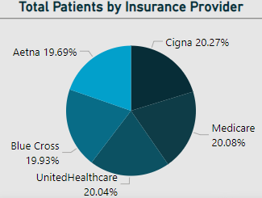
8. Which insurance provider has highest number of patients enrolled?
Cigna has recorded the highest number of patients as their clients, followed closely by Medicare and United Healthcare. The differences among the various insurance providers are negligible

Slide 16
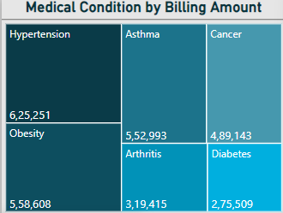
9. Which medical condition has the highest and lowest recorded amounts?
Hypertension has the highest recorded billing amount, while Diabetes has the lowest.
Although diabetes is the 2nd top medical condition among patients, hypertension has recorded the highest
billing amount

Slide 17
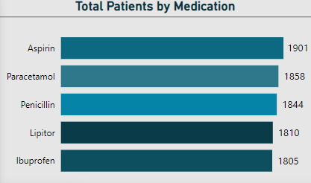
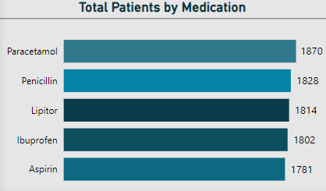
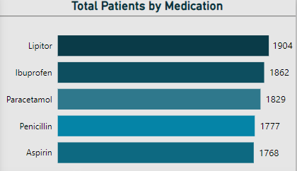
10. Which medication is mostly used to treat each medical condition?
For arthritis, aspirin is the most commonly used medication.
For asthma, paracetamol is the most frequently used.
In the case of cancer, Lipitor is the most widely prescribed.
For diabetes, Lipitor is also the most commonly used medication.
For hypertension, ibuprofen is used the most, while for obesity, penicillin is the most frequently prescribed treatment.
Arthritis
Asthma
Cancer

Slide 18
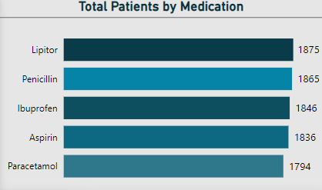
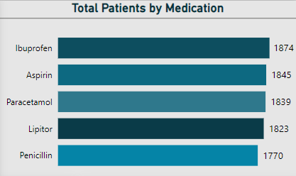
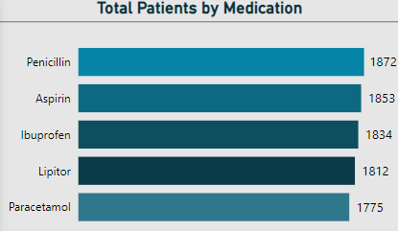
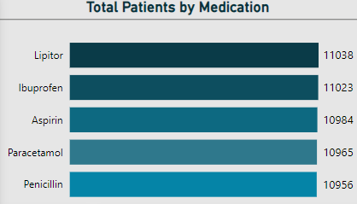
Diabetes
Hypertension
Obesity
To conclude, Lipitor is the most used medication, followed by Ibuprofen

Slide 19
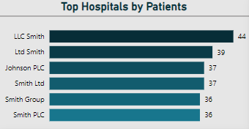
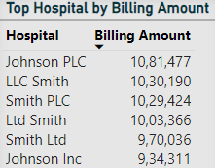
11. How do the top hospitals compare in terms of patient numbers versus billing amounts?
Although LLC Smith Hospital leads in terms of patient numbers, Johnson PLC generates significantly higher billing amounts.
Ltd Smith ranks second in terms of patient numbers, but when it comes to billing amounts, it holds the second-to-last position among the top 6 hospitals
It shows that there is no high correlation between number of patients in each hospital and billing amount

Slide 20
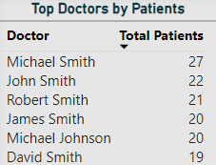
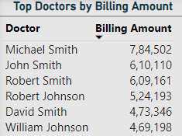
12. How do the top doctors compare in terms of patient numbers versus billing amounts?
There is a noticeable correlation between the top doctors by the number of patients they treat and
those ranked highest by billing amount

Slide 21
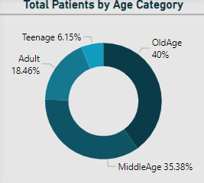
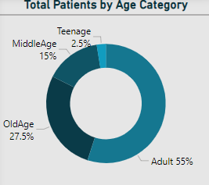
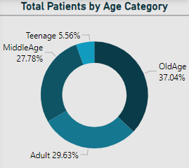
14. How are medical conditions distributed across different age categories?
The majority of patients with arthritis belong to the older age group, followed by the middle-aged category.
Asthma is more prevalent among older adults and old age.
Cancer is more commonly observed across adults, middle-aged, and older age groups.
Arthritis
Asthma
Cancer

Slide 22
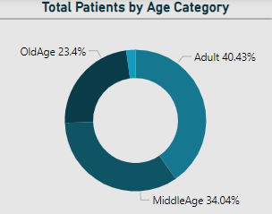
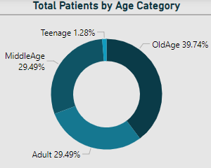
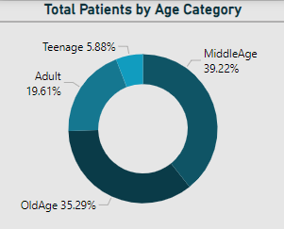
Among patients suffering from diabetes, adults make up the largest group, followed by middle-aged individuals.
Among patients with hypertension, older individuals are the most affected, followed by adults and middle-aged individuals in equal proportions.
Among patients with obesity, middle-aged individuals are the most affected, followed by older individuals.
Diabetes
Hypertension
Obesity

Slide 23
RECOMMENDATIONS

Slide 24
Hospital Improvement: Johnson PLC and LLC Smith can improve services to attract more patients and reach the top.
Capacity Expansion: Hospitals should enhance facilities for arthritis and diabetes care due to their prevalence.
Arthritis Focus: Doctors need to prioritize improving conditions for arthritis patients with abnormal test results.
Insurance Competition: Cigna should offer attractive policies to compete with United Healthcare and Medicare, while the latter can enhance services to maintain their edge.
Medication Investment: Hospitals should prioritize Lipitor and ibuprofen while Johnson PLC and LLC Smith could lower billing rates to improve their rankings.
Fee Reduction: Michael Smith could lower fees to attract more patients and retain his top position.

Slide 25
6. Age Category and medical conditions
Middle-aged individuals should take preventive steps to avoid arthritis.
Adults with asthma should practice yoga or physical exercise to improve their condition.
Adults and middle-aged individuals should focus on a healthy diet to manage diabetes.
Older adults should monitor their diet and stay active to manage hypertension.
Middle-aged and older individuals should incorporate exercise into their routine to prevent obesity-related complications

Slide 26


Slide 27
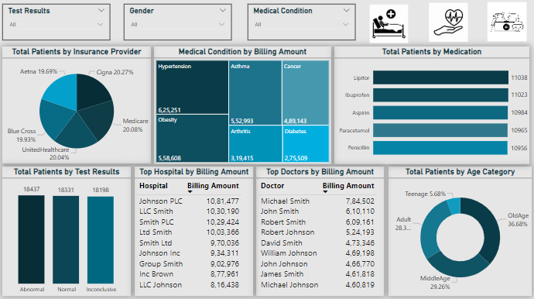

Slide 28
THANK YOU

